Slide 1
A Federated Approach for Classification of Alzheimer's Disease
Task 4 : Based on Paper First Draft
CSE707: Distributed Computing Systems
Instructor: Annajiat Alim Rasel (AAR)
RA: Md. Sabbir Hossain
ST: Farah Binta Haque
Team: 22
Name: Sameha Kamrul, ID: 23266016
Name: Rifat Alam Pomil, ID: 23266028
Name: Marshia Nujhat, ID: 23266030
Name: Ahmed Mahir Ruhan, ID: 23366025

Slide 2
Outline
Literature Review
Collected Data
Proposed Methodology

Slide 3
Literature Review
A CNN based framework for classification of Alzheimer’s disease (Y. AbdulAzeem, W. M. Bahgat, and M. Badawy)
Alzheimer disease classification can be handled through CNN based framework
This paper’s proposed model achieved 99.6%, 99.8% and 97.8% accuracy on classifications on the ADNI dataset.
The proposed algorithm framework consists of five layers,
1. Acquisition and annotation,
2. Preprocessing and Augmentation,
3. Cross-validation,
4.CNN model
5.AD-classification.

Slide 4
Literature Review
A Federated Learning Model Based on Hardware Acceleration for the Early Detection of Alzheimer’s Disease ( M. Bruscoli and S. Lovestone)
Blood biosamples are extremely important to detect in early stages
VHDL and Altere 10 GX FPGA were used for Hardware acceleration approaches.
Proposed method achieved 89% accuracy and 87% sensitivity for early detection of the disease.

Slide 5
Literature Review
A novel decentralized federated learning approach to train on globally distributed, poor quality, and protected private medical data (K. Khalil, M. M. R. Khan Mamun, A. Sherif, M. S. Elsersy, A. A. A. Imam, M. Mahmoud, and M. Alsabaan)
Decentralized federated learning approach for training on distributed systems.
Non-medical data and medical data efficacy of decentralized AI training approaches was tested.
Model clustering algorithm was used to reduce model transfer cost.

Slide 6
Literature Review
Convolutional Neural Networks for Classification of Alzheimer’s Disease: Overview and Reproducible Evaluation (B. McMahan, E. Moore, D. Ramage, S. Hampson, and B. A. y Arcas)
Data privacy is always important no matter what type of classification process is undergoing.
Data augmentation is performed after training of the dataset.
The main backlog was the accuracy is lesser then the 3D subject-level approach.

Slide 7
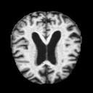
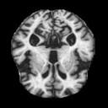
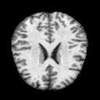
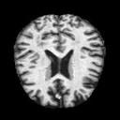
Collected Data
Mild Demented : 896 images
Moderate Demented: 64 images
Non Demented: 3200 images
Very Mild Demented: 2240 images
Collected from Kaggle
It has 4 classes
Data consists 6400 MRI images (128, 128)

Slide 8
Proposed Methodology
Primary Steps:
Different level of Alzheimer's disease data gatherings
Data processing
Creation of the clients
Data training with federated learning based model
Evaluating results of the model

Slide 9
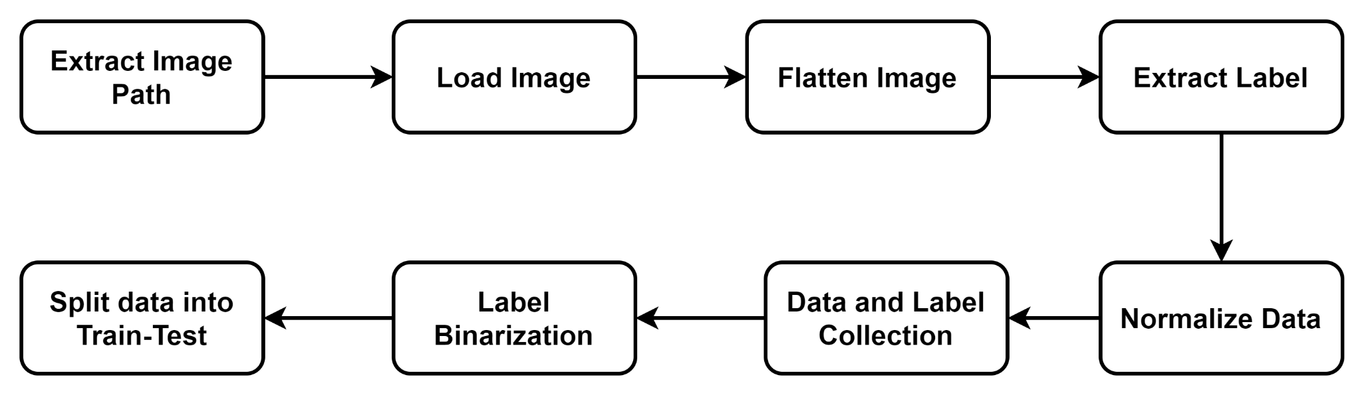
Proposed Methodology (Pre Processing)

Slide 10
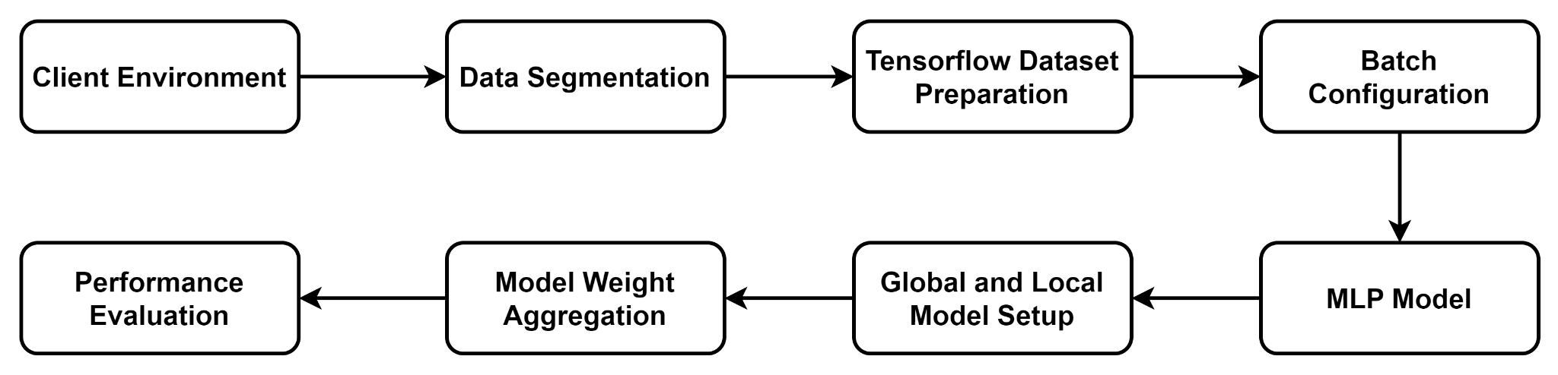
Proposed Methodology (Model Training)

Slide 11
Reference
[1] Y. AbdulAzeem, W. M. Bahgat, and M. Badawy, “A cnn based frame- work for classification of alzheimer’s disease,” Neural Computing and Applications, vol. 33, pp. 10415–10428, 2021.
[2] M. Bruscoli and S. Lovestone, “Is mci really just early dementia? a systematic review of conversion studies,” International psychogeriatrics, vol. 16, no. 2, pp. 129–140, 2004.
[3] K. Khalil, M. M. R. Khan Mamun, A. Sherif, M. S. Elsersy, A. A. A. Imam, M. Mahmoud, and M. Alsabaan, “A federated learning model based on hardware acceleration for the early detection of alzheimer’s disease,” Sensors, vol. 23, no. 19, p. 8272, 2023.
[4] S. Nazir and M. Kaleem, “Federated learning for medical image analysis with deep neural networks,” Diagnostics, vol. 13, no. 9, p. 1532, 2023.
[5] B. McMahan, E. Moore, D. Ramage, S. Hampson, and B. A. y Arcas, “Communication-efficient learning of deep networks from decentralized data,” in Artificial intelligence and statistics, pp. 1273–1282, PMLR, 2017.

Slide 12
Thank you for listening.

